Slide 1

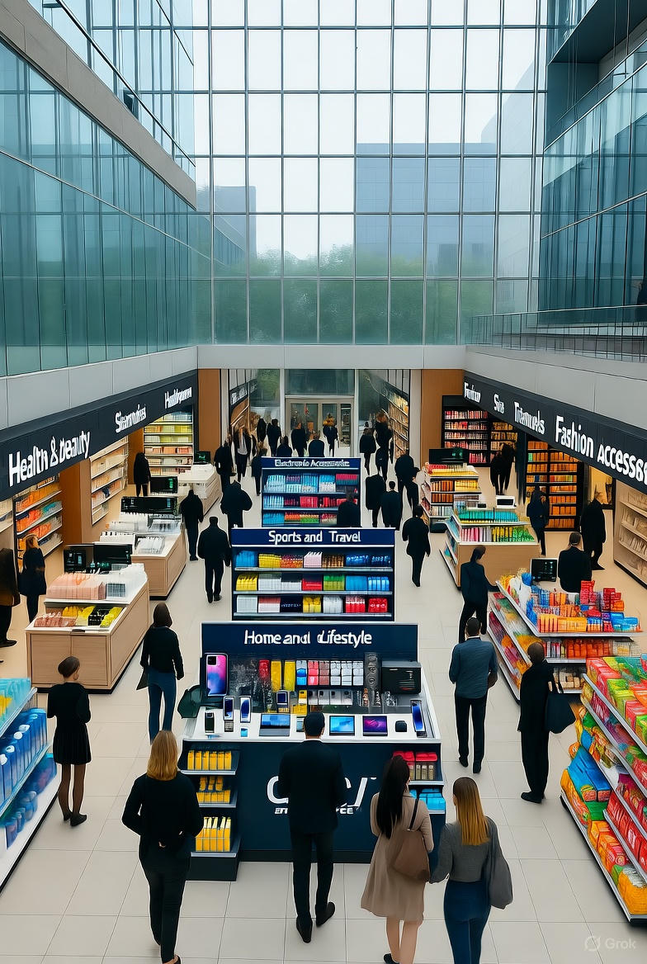
NUMERIDEX SUPERMARKET
Numeridex
Supermarket
Sales Analysis
Prepared by: Group A (Power BI)

Slide 2

Introduction
This project analyzes a supermarket sales dataset to identify sales trends, understand customer purchasing behavior, and evaluate overall business performance. Using Power BI, the data was cleaned, transformed, and visualized through interactive dashboards. The insights gained support data-driven decision-making for future growth.

Slide 3
Overview
This project analyzes a supermarket sales dataset containing detailed information on customer transactions across multiple branches.
The dataset captures detailed transaction information from January through March 2019, with 100 records representing customer purchases.
The aim is to identify sales trends, understand customer purchasing behavior, and evaluate overall business performance to support data-driven decision-making for future growth.

Slide 4
Analyze Sales Performance
Evaluate Customer Behavior:
Assess purchasing behavior based on customer type, gender, and payment method
Identify key revenue drivers across categories, cities, and branches
Monitor Monthly Trends:
Assess Product Performance
Project Objectives
Identify peak and low-performing sales periods
Compare sales and average unit prices across cities
Measure Customer Satisfaction
Understand Branch Performance
Use the average rating metric to gauge customer engagement
Analyze how customer type influences sales at each branch
Identify Actionable Insights
Guide business strategies to improve sales and customer experience

Slide 5

Tools & Methods
Excel
Power BI
Used for data preparation, including removing irrelevant columns, checking for blank cells, and verifying numerical accuracy
The cleaned data was imported into Power BI for visualization and dashboard creation

Slide 6

Key Performance Indicators (KPIs)
33,630
100
Total Sales
Total Transaction
6.89
582
Avg. Rating
Quantity Sold
1 .74k
Total Tax(5%)

Slide 7

Sales Performance Overview
Total Sales By Product Line
Total Sales By Month
Quantity Sold By City
Customer Count By Branch(Type)
Average Price By City
Gender Distribution

Slide 8
Dashboard Design Overview
The interactive dashboard features various charts for comprehensive data visualization:
Clustered Column Charts: Count of Customer type by branch
Clustered Bar Charts: Average unit price by product line
Stacked Bar: Total Sales by product line
Doughnut Chart: Quantity sold by city.
Pie Chart: Gender distribution.
Line Chart: Total sales by month.
Cards: Key performance metrics .
Slicers allow filtering by branch, customer type, payment method.

Slide 9
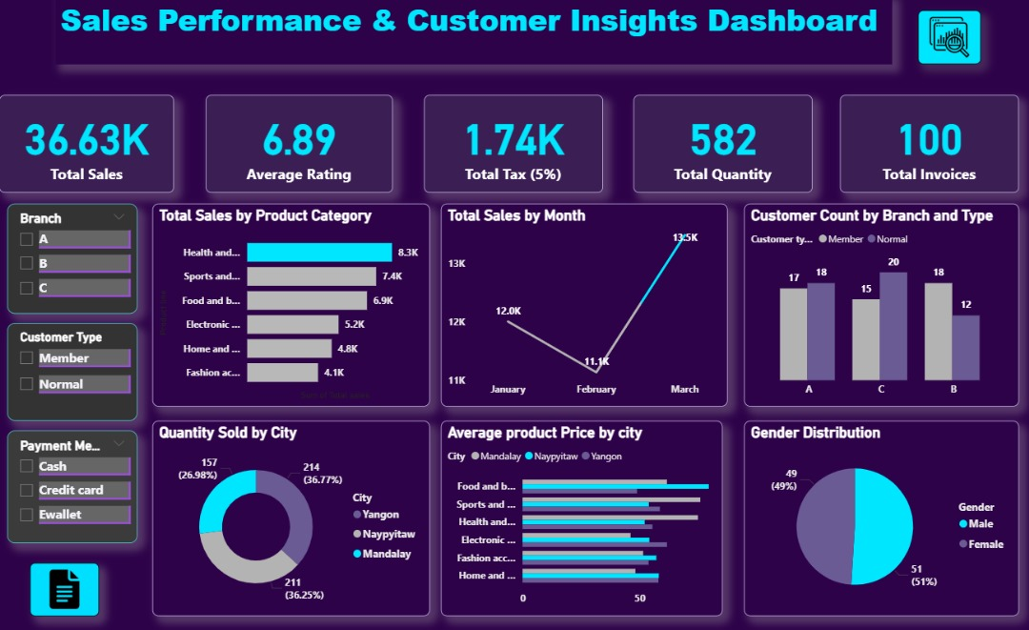

Slide 10

Key Insights
Health & Beauty, Sports & Travel, and Food & Beverages are the top-performing categories driving revenue.
Branch C (Naypyitaw) recorded the highest sales
E-wallet payments are the most preferred payment method
Normal customers generate more total revenue than Members.
Sales performance peaked in March after a February dip
The average customer rating of 6.89 indicates moderate satisfaction and opportunities for improvement
Electronic Accessories and Fashion Accessories significantly underperformed

Slide 11
Recommendations
Capitalize on Demand: Increase stock and promotional activities for Health & Beauty, Sports & Travel, and Food & Beverages
Address Underperformance: : Investigate and address the low sales of Electronic Accessories and Fashion Accessories through pricing reviews or repositioning.
Replicate Success: Offer loyalty programs for Electronics customers; provide bulk discounts for Furniture buyers.
Boost Loyalty: Strengthen membership programs with exclusive benefits to convert more normal customers into loyal members
Incentivize E-wallets: Introduce incentives like cashback or loyalty points for E-wallet payments.
Improve Service: Enhance customer experience and service quality to raise the average rating above 6.89
Bundle Products: Implement strategic bundling of underperforming products with top sellers

Slide 12

Conclusion
This analysis successfully identified key drivers of sales performance, customer behavior, and payment preferences. The findings highlighted seasonal patterns, regional variations in demand, and areas requiring service improvement. These insights provide management with a data-driven foundation to make informed strategic decisions, optimize efficiency, and enhance customer loyalty.

Slide 13

c
Thank You for Your Attention!

